Slide 1
Data 604 – Data Management
Week 1 – Introduction and history of databases
Notes:
This section will cover several categories of Data Analytic Techniques.

Slide 2
Introduction
Hang Yue
About Me
How to reach me – yuehang@umbc.edu
TA: Rohan Jacob, rjacob2@umbc.edu
Syllabus
Expectations
Grading

Slide 3
About this course
This course starts with the basics of traditional database systems and then transitions to the emerging and exciting efforts to solve big data challenges through the use of Cloud and Hadoop technologies
There are homework assignments/labs, a midterm exam, and a group project as the final exam

Slide 4
Expectations
My goal is to provide you with:
Expert-driven learning materials, content, and practical exercises
Examples of real-world experiences
A supportive, engaging, and challenging learning experience
Ways that you can succeed in this class:
Attend and pay attention to the lectures (avoid texting or messaging except for emergencies, please leave the classroom to take cell phone calls)
Set aside blocks of weekly time to complete the reading, labs, and exercises
Reach out early and often when you need help

Slide 5
Grading
Course work | Grade Distribution
Homework/Labs | 30%
Midterm Exam | 35%
Group Project | 35%
Final Grade will be computed as follows:
90-100% | A
80-89% | B
70-79% | C
60-69% | D
<60% | F

Slide 6
Class Survey
Goal is to help instructor
understand range of skills and experiences of the students
inform team project assignments
determine if any course content needs to be modified
Please be sure to turn in survey forms to instructor prior to end of class

Slide 7
Things to Consider
Why do you need this course?
How can this course help your career?
How can this course improve your data science efforts?

Slide 8
Tips
Leverage technical documentation
Practice- apply what you have learned
Leverage your strengths
Understand your weaknesses and shore them up with the strengths of your colleagues
Computing power, get the most you can afford or leverage UMBCs virtual environments
Take it day by day
Your assignment submissions should be your own, do not risk your grades by cheating

Slide 9

Definitions
Database: organized collection of logically related data
Data: stored representations of meaningful objects and events
Structured: numbers, text, dates
Unstructured: images, video, documents
Information: data processed to increase knowledge in the person using the data
Metadata: data that describes the properties and context of user data
Copyright © 2019, 2016, 2013 Pearson Education, Inc. All Rights Reserved
Notes:
Data by itself is not very useful. It is only after the data has been processed, summarized, and organized that it becomes useful for decision makers and knowledge workers. Processed data becomes information, which is often made available to users in the form of reports or graphical displays.
Metadata really pertains to the underlying structure of the data. When you design a database, you are specifying its metadata. When you populate the database, you are putting data into it.

Slide 10
Applications of Databases
Storage and retrieval of traditional numeric and alphanumeric data in an inventory application
Multimedia applications (e.g., YouTube, Spotify)
Biometric applications (e.g., fingerprints, retina scans)
Wearable applications (e.g., FitBit, Apple Watch)
Geographical information systems (GIS) applications (e.g., Google Maps)
Sensor applications (e.g., nuclear reactor)
Big Data applications (e.g., Walmart)
Internet of Things (IoT) applications (e.g., Telematics)
Copyright © 2019 Principles of Database Management. All Rights Reserved

Slide 11
History of Databases
Learning Objectives
Understand limitations of file systems
Discuss evolution of relational databases and their advantages
Understand types of databases systems and their use cases
Know the elements that make up a relational database system

Slide 12

Paper / Files
Paper, hand typed or written forms
Information stored in folders, filing cabinets
Where do you see this today?
This Photo by Unknown Author is licensed under CC BY-SA

Slide 13

Digitized Files
Electronic versions of filing cabinet
Can save physical space (e.g. digitized videos)
Without system though, it has same manual limitations.
If you want a count of the videos,
you have to count them.
This Photo by Unknown Author is licensed under CC BY-SA

Slide 14
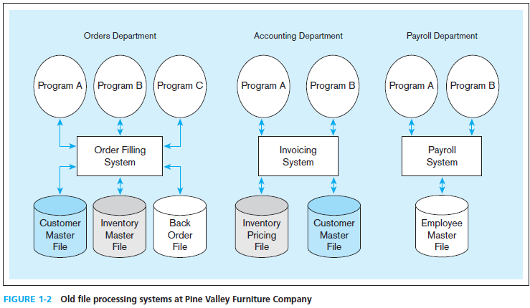
Disadvantages of File Processing
Program-Data Dependence
All programs maintain metadata for each file they use
Duplication of Data
Different systems/programs have separate copies of the same data
Limited Data Sharing
No centralized control of data
Lengthy Development Times
Programmers must design their own file formats
Excessive Program Maintenance
80% of information systems budget
Notes:
Prior to the advent of databases, data was stored in individual files, each being used by a separate program. This was the traditional file processing approach to data storage. As business applications became more complex, it became evident that traditional file processing systems had a number of shortcomings and limitations. Database systems were developed to overcome these shortcomings. However, there is still a lot of data that is stored in traditional file systems. Legacy systems still abound with traditional files. Even Excel spreadsheets, which are relatively modern, would fall within the same category as file systems. Many companies store their important data in a myriad of spreadsheets, and as their businesses become more complex they run up against the limitations of these storage methods.
Program-data dependence: The Customer Master File is used in the Order Filling System and the Invoicing System. Suppose it is decided to change the customer address field length in the records in this file from 30 to 40 characters. The file descriptions in each program that are affected (up to five programs) would have to be modified. It is often difficult to even locate all programs affected by such changes.
Duplication of data: Note two different files containing inventory data. One is used for order filling and the other for invoicing. This duplication is wasteful because it requires additional storage space and increased effort to keep all files up to date. Data formats may be inconsistent, data values may not agree, or both. Reliable metadata is very difficult to establish in file processing systems.
To recap the File approach caused
duplicate or redundant information to be stored
danger of inconsistent data
strong coupling between applications and data
hard to manage concurrency control
hard to integrate applications aimed at providing cross-company services

Slide 15
Can you think of examples?
Christmas card list
Address and phone book
Notes:
Ask the students for examples

Slide 16
Motivation for Databases
Driven by four main objectives:
Need for program-data independence in order to reduce maintenance
Desire to manage more complex data types and structures
Ease of data access for less technical personnel
Need for more powerful decision support platforms
Copyright © 2019, 2016, 2013 Pearson Education, Inc. All Rights Reserved
Notes:
Here are some of the motivations that led to the evolution of database systems.

Slide 17
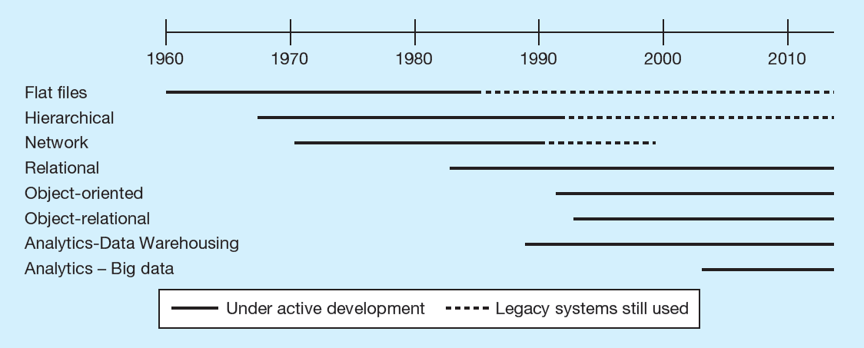
Evolution of Databases
Copyright © 2019, 2016, 2013 Pearson Education, Inc. All Rights Reserved
Notes:
Over the years since the advent of computer data processing systems in business, there have been many approaches to database technology. We already discussed flat files and their problems. Early attempts to solve these problems led to hierarchical and network databases. Legacy systems, those initially created in the 1950s and 1960s, sometimes still use these earlier technologies.
The relational database is the most common form, especially for business applications. However, others also exist, including object-oriented and object-relational. Data warehousing is commonly used for managerial decision making.
Neo4j – graph db initial release 2007
Hadoop 2011
Sql Server early 1990s
IBM 1979, 80s
Oracle – 1979, 80s

Slide 18
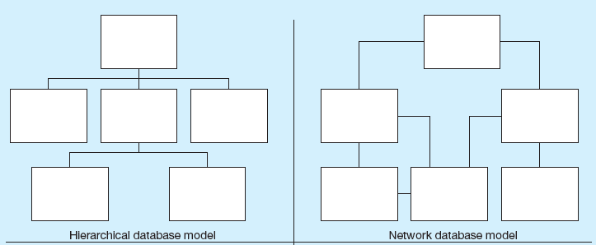
Early Database Systems
Copyright © 2019, 2016, 2013 Pearson Education, Inc. All Rights Reserved

Slide 19
Early Database Systems
The hierarchical and network database models were the earliest attempts to structure data according to relationships between entities. But they fell short because they were very inflexible. For example, many-to-many relationships are impossible in hierarchical databases; and although they are possible in network models, the are difficult to modify in these structures.
According to wiki- Hierarchical only allows one to many relations. It was IBMs first attempt at a database.
VSAM (virtual storage access method) is a form of a hierarchical database https://www.ibm.com/support/knowledgecenter/zosbasics/com.ibm.zos.zconcepts/zconcepts_169.htm
Social Security Administration Electronic Service Provision: A Strategic Assessment – legacy system to store data in 1980s was a custom build file storage system MADAM- Master Data Access Method, built on top of VSAM. CA-IDM- integrated data management Files are read first in first out.
Network model – similar to graph structure. Each record can have many to many relationships in any direction. Relationships are explicitly defined as opposed to implicit of foreign keys. Integrated Data Store (IDM). Example is CA-IDM -integrated data management
Copyright © 2019, 2016, 2013 Pearson Education, Inc. All Rights Reserved

Slide 20
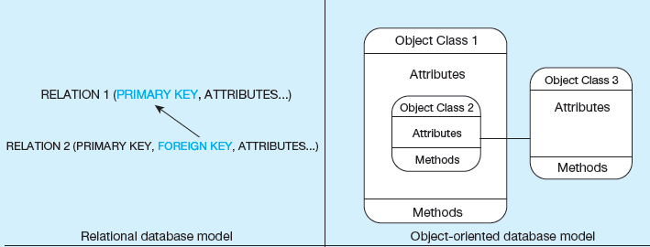
Relational Database
Relational Databases
Database technology involving tables (relations) representing entities and primary/foreign keys representing relationships
Copyright © 2019, 2016, 2013 Pearson Education, Inc. All Rights Reserved

Slide 21
Relational Database
A database system is considered relational if it meets most of 13 rules of the Codds 12 rules for relational data models https://www.w3resource.com/sql/sql-basic/codd-12-rule-relation.php
The relational model is the most ubiquitous, and represents relationships as primary-to-foreign key associations in different “relations”. Here we see some confusing terminology. There is the concept of “relationship”, which was shown as lines between boxes in figure. And there is another concept of “relation”, which is really like a database table.
Object-oriented databases are interesting in that they allow for a sort of inheritance between classes and subclasses. Also, unlike relations (tables) in relational databases, objects in object-oriented databases are capable of behaviors (program code) in the form of “methods”. If you take a course in Java or another object-oriented language, you will become familiar with these ideas.
Notes:
Dr. Edgar Frank Codd (1923 – 2003)

Slide 22

File versus Database Approach to Data Management
File approach
Procedure FindCustomer;
begin open file Customer.txt;
Read(Customer)
While not EOF(Customer)
If Customer.name='Bart' then
display(Customer);
EndIf
Read(Customer);
EndWhile;
End;
Database approach (SQL)
SELECT *
FROM Customer
WHERE
name = 'Bart'

Slide 23
Database Systems
The database management system (DBMS) is a software system that is used to create, maintain, and provide controlled access to user databases.
Most current DBMSs are in the form of relational databases, which represent data as a collection of tables in which all data relationships are represented by common values in related tables. We will explore relational databases in detail throughout this course.
Note that because all the data is shared in a central database, there is no longer the need for separate systems and programs to maintain their own copy of the data. This reduces duplication and increases integrity.
Copyright © 2019, 2016, 2013 Pearson Education, Inc. All Rights Reserved

Slide 24
Database Systems
Copyright © 2019 Principles of Database Management. All Rights Reserved

Slide 25
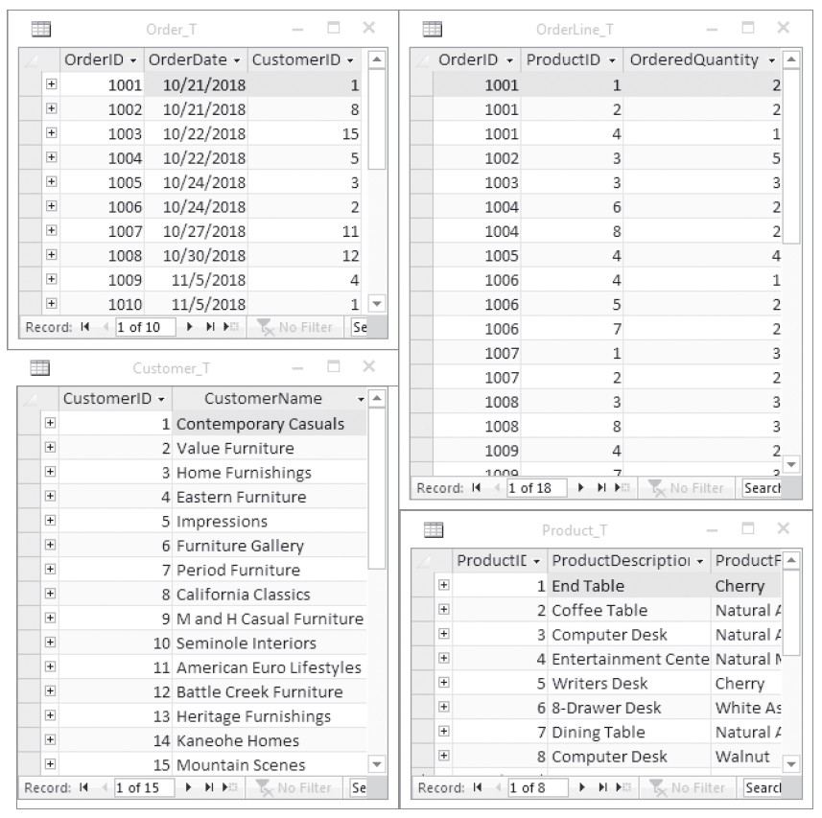
Database Management System (DBMS)
Copyright © 2019, 2016, 2013 Pearson Education, Inc. All Rights Reserved
Notes:
The database management system (DBMS) is a software system that is used to create, maintain, and provide controlled access to user databases.
Most current DBMSs are in the form of relational databases, which represent data as a collection of tables in which all data relationships are represented by common values in related tables. We will explore relational databases in detail throughout this course.
Note that because all the data is shared in a central database, there is no longer the need for separate systems and programs to maintain their own copy of the data. This reduces duplication and increases integrity.

Slide 26
Database Systems – Common Uses
Personal Databases
Typical size in the megabytes
Intended for one user
Departmental Multi-Tiered Client/Server Databases
Typical size in the gigabytes
Intended for several users, usually doesn’t exceed 100, department-wide
Enterprise Applications
Typical size in the gigabytes, terabytes, or even petabytes
Intended for a very large user base, company wide
Copyright © 2019, 2016, 2013 Pearson Education, Inc. All Rights Reserved

Slide 27
Categorization based on architecture
Centralized DBMS architecture
Client server DBMS architecture
n-tier DBMS architecture (data tier, logic tier, etc)
Cloud DBMS architecture
Federated DBMS (a type of meta-database management system)
in-memory DBMS
Notes:
DMBS can be categorized based on architecture and Usage.
Centralized DBMS architecture
data is maintained on a centralized server
Client server DBMS architecture
active clients request services from passive servers
fat server versus fat client variant
n-tier DBMS architecture
client with GUI functionality, application server with applications, database server with DBMS and database, and web server for web based access
Cloud DBMS architecture
DBMS and database are hosted by a third-party cloud provider
E.g., Apache Cassandra project and Google’s BigTable
Federated DBMS
provides a uniform interface to multiple underlying data sources
hides the underlying storage details to facilitate data access
in-memory DBMS
stores all data in internal memory instead of slower external storage (e.g., disk)
often used for real-time purposes
E.g., HANA (SAP)

Slide 28
Categorization based on usage
On-line transaction processing (OLTP)
On-line analytical processing (OLAP)
Big Data & Analytics
Multimedia
Spatial applications
Sensoring
Mobile
Open source
Notes:
On-line transaction processing (OLTP)
focus on managing operational or transactional data
database server must be able to process lots of simple transactions per unit of time
DBMS must have good support for processing a high volume of short, simple queries
On-line analytical processing (OLAP)
focus on using operational data for tactical or strategical decision making
limited number of users formulates complex queries
DBMS should support efficient processing of complex queries which often come in smaller volumes
Big Data & Analytics
NoSQL databases
focus on more flexible, or even schema-less, database structures
store unstructured information such as emails, text documents, Twitter tweets, Facebook posts, etc.
Multimedia
Multimedia DBMSs provide storage of multimedia data such as text, images, audio, video, 3D games, etc.
should also provide content-based query facilities
Spatial applications
spatial DBMSs support storage and querying of spatial data (both 2D and 3D)
Geographical Information Systems (GIS)
Sensoring
sensor DBMSs manage sensor data such as biometric data from wearables, or telematics data
Mobile
Mobile DBMSs run on smartphones, tablets or other mobile devices.
should always be online, have a small footprint and be able to deal with limited processing power, storage and battery life
Open source
code of open source DBMSs is publicly available and can be extended by anyone
See www.sourceforge.net
E.g., MySQL (Oracle)

Slide 29
Categorization based on data model
Hierarchical DBMSs
Network DBMSs
Relational DBMSs
Object-Oriented DBMSs (OODBMS)
Object-Relational DBMSs (ORDBMSs)
XML DBMSs
NoSQL DBMSs
Notes:
Databases can be categorized based on
Hierarchical DBMSs
adopt a tree like data model
DML is procedural and record oriented
no query processor (logical and internal data model intertwined)
E.g., IMS (IBM)
Network DBMSs
use a network data model
CODASYL DBMSs
DML is procedural and record oriented
no query processor (logical and internal data model intertwined)
CA-IDMS (Computer Associates)
Relational DBMSs
use the relational data model
currently the most popular in industry
SQL (declarative and set oriented)
query processor
strict separation between the logical and internal data model
E.g., MySQL (open source, Oracle), Oracle DBMS (Oracle), DB2 (IBM), Microsoft SQL (Microsoft)
Object-Oriented DBMSs (OODBMS)
based upon the OO data model
No impedance mismatch in combination with OO host language
E.g., db4o (open source, Versant), Caché (Intersystems) GemStone/S (GemTalk Systems)
only successful in niche markets, due to their complexity
A class is a blueprint definition for a set of objects
Compare to entity type in ER
Conversely, an object is an instance of a class
Compare to entity in ER
Object is characterized by both variables and methods
Variables correspond to attribute types and variable values to attributes in the ER
No ER equivalent for methods
Object-Relational DBMSs (ORDBMSs)
also referred to as extended relational DBMSs (ERDBMSs)
use a relational model extended with OO concepts
DML is SQL (declarative and set oriented)
E.g., Oracle DBMS (Oracle), DB2 (IBM), Microsoft SQL (Microsoft)
XML DBMSs
use the XML data model to store data
Native XML DBMSs (e.g., BaseX, eXist) map the tree structure of an XML document to a physical storage structure
XML-enabled DBMSs (e.g., Oracle, IBM DB2) are existing DBMSs that are extended with facilities to store XML data
NoSQL DBMSs which are
targeted at storing big and unstructured data
can be classified into key-value stores, column-oriented databases and graph databases
focus on scalability and the ability to cope with irregular or highly volatile data structures
E.g., Apache Hadoop, MongoDB, Neo4j

Slide 30
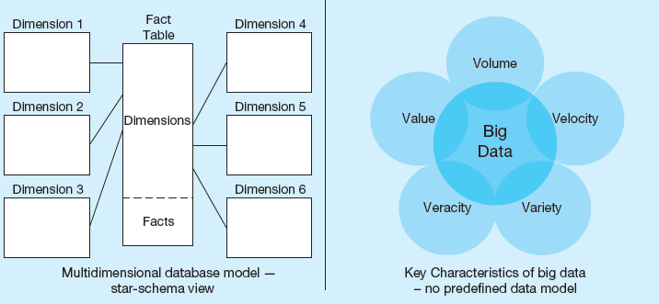
Informational Databases
Copyright © 2019, 2016, 2013 Pearson Education, Inc. All Rights Reserved
Notes:
Multidimensional models are typically based on data warehouses, and are used for decision support purposes. The star schema is a typical data warehouse structure. It’s still a relational database, but here there are two types of tables. Fact tables contain numerical data that can be aggregated (prices, sales revenue, payments, etc.). Dimensions are different “lenses” by which you can slice and dice the numerical data (customers, departments, products, time periods, etc.). The term Online Analytical Processing (OLAP) refers to the types of systems that use multidimensional data.
Big data is an emerging concern and opportunity for business. This refers to the huge amount of often unstructured data (such as tweets, customer reviews, blogs, emails, etc.) that are increasingly important for business decision-making. The Vs (volume, velocity, variety, veracity, and value) are big buzzword in the big data world.

Slide 31
Relational Databases - Advantages
Program-data independence
Planned data redundancy
Improved data consistency
Improved data sharing
Increased application development productivity
Enforcement of standards
Improved data quality
Improved data accessibility and responsiveness
Reduced program maintenance
Improved decision support
Copyright © 2019, 2016, 2013 Pearson Education, Inc. All Rights Reserved

Slide 32
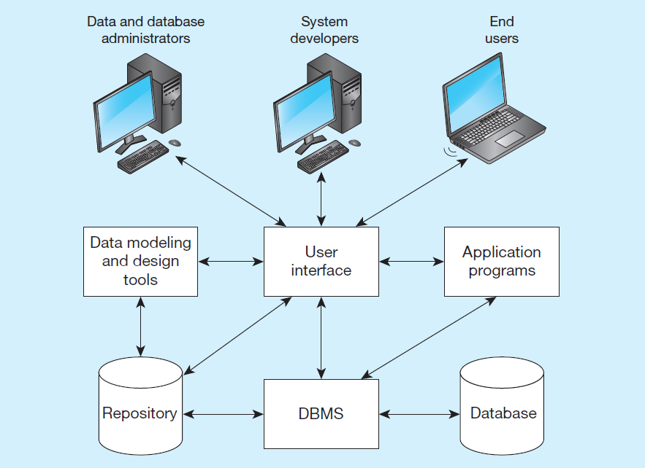
Database Components
Copyright © 2019, 2016, 2013 Pearson Education, Inc. All Rights Reserved
Notes:
Data modeling and design tools are automated tools used to design databases and application programs. These tools help with creation of data models and in some cases can also help automatically generate the “code” needed to create the database.
A repository is a centralized knowledge base for all data definitions, data relationships, screen and report formats, and other system components. In other words, the metadata resides in the repository.
DBMS is a software system that is used to create, maintain, and provide controlled access to databases. A database is an organized collection of logically related data, usually designed to meet the information needs of multiple users in an organization. A database is not the same as a repository. The database contains data, whereas the repository contains metadata. In other words, the repository defines the structure of the data.
Application programs interact with the database to provide functionality of use for the company. Relating this to figure 1-2, the application programs fulfill the order processing, invoicing, and payroll functions.
The user interface includes languages, menus, and other facilities by which users interact with various system components. Most application programs will involve user interfaces, because they will be directly used by people (users). However, not all applications involve user interfaces; some are run as batch programs in the background. For example, a program that prints paychecks may not include a user interface.
Different types of users include data and database administrators, system developers, and end users. The data administrators manage the data and database. The developers create the application programs. The end users are people who use the systems for various business functions. These can include accountants, sales people, managers, etc. Database administrators and system developers are IT people, and their principal clientele are end users.

Slide 33
Databases Components
Data modeling and design tools – automated tools used to design databases and application programs
Repository – centralized storehouse of metadata
Database Management System (DBMS) – software for managing the database
Database – storehouse of the data
Application Programs – software using the data
User Interface – text, graphical displays, menus, etc. for user
Data/Database Administrators – personnel responsible for maintaining the database
System Developers – personnel responsible for designing databases and software
End Users – people who use the applications and databases
Copyright © 2019, 2016, 2013 Pearson Education, Inc. All Rights Reserved

Slide 34
Database Catalog
Heart of the DBMS
Contains the data definitions, or metadata, of your database application
Stores the definitions of the views, logical and internal data models, and synchronizes these three data models to make sure their consistency is guaranteed
Notes:
The catalog holds the metadata in the database. It stores the definitions of database objects such as tables, views, indexs, etc.
The catalog provides an important source of information for end users, applicaiton developers and the database itrself.

Slide 35
Database Project Team Members
Users – the “customers” communicate their needs to analysts
Information Architect & Business analysts – analyze business situation and establish requirements
Systems analysts – like business analysts, but also have technical expertise for overall information systems
Database analysts and data modelers – analysts who focus on database
Programmers – coders of the programs that interact with the database
Notes:
There are many different people, each with different perspectives, skills, and needs, involved in a systems development project.
Business user will run these applications to perform specific database operations
Information architect in conjunction with business & systems analyst, designs the conceptual data model closely interacts with the business user
Database designer i.e Database analysts and data modelers translates the conceptual data model into a logical and internal data model
Database administrator (DBA) is responsible for the implementation and monitoring of the database
Application developer or programmer develops database applications in a programming language such as Java or Python

Slide 36
ACID Transactions
Atomicity – all transaction items succeed or fail
Consistency (Correctness) – items meet validation constraints
Isolation – transactions isolated from each other; system enables way to manage conflicts
Durability – transaction changes are permanent
https://en.wikipedia.org/wiki/ACID_(computer_science)
Page 320-322 of T-SQL Fundamentals textbook and Page 15 of Principles of Database Management

Slide 37
CAP Theorem
Consistency -all nodes have the most recently written data
Availability – all requests receive a response, without the guarantee that it contains the most recent write
Partition Tolerance - data is still available during partition loss
A distributed system can at most solve two of the three conditions simultaneously.
p. 312-313, 539 Principles of Database Management text
When a network partition failure happens should we decide to
Cancel the operation and thus decrease the availability but ensure consistency
Proceed with the operation and thus provide availability but risk inconsistency
https://en.wikipedia.org/wiki/CAP_theorem

Slide 38
Data Model
A database model is comprised of different data models, each describing the data from different perspectives
A data model provides a clear and unambiguous description of the data items, their relationships and various data constraints from a particular perspective
They are of following types
Conceptual data model
Logical data model
Physical data model
Notes:
A conceptual data model provides a high-level description of the data items with their characteristics and relationships
communication instrument between information architect and business user
should be implementation independent, user-friendly, and close to how the business user perceives the data
usually represented using an Enhanced-Entity Relationship (EER) model, or an object-oriented model
Logical data model is a translation or mapping of the conceptual data model towards a specific implementation environment
can be a hierarchical, CODASYL, relational, object-oriented, extended relational, XML or NoSQL model
Logical data model can be mapped to an internal data model that represents the data’s physical storage details
clearly describes which data is stored where, in what format, which indexes are provided to speed up retrieval, etc.
highly DBMS specific
External data model contains various subsets of the data items in the logical model, also called views, tailored towards the needs of specific applications or groups of users
Difference between Physical data model and logical data model
A physical data model defines the physical structure of the database - logical model is high level and does not include structure of database
Physical data model depends on the database management system used - logical data model is independent of the database management system used.
Physical data model includes tables, columns, data types, primary and foreign key constraints, triggers and stored procedures - logical data model includes entities, attributes, relationships and keys.
The logical data model is first derived from the business requirements. The physical data model is derived from the logical data model.
The logical data model is normalized (potentially to) to fourth normal form. The physical database model could be deformalized to meet the requirements as necessary.

Slide 39
Database Design – Field Types
VARCHAR2(length) max 400 characters
Variable-length character data. A string that is shorter than the maximum length will consume only the required space.
N VARCHAR2 is Unicode.
CHAR(length) max 200 characters
Fixed length character data. N CHAR is Unicode.
C L O B
Character large object, capable of storing up to 4 gigabytes of one variable length character data field
NUMBER
Positive or negative number. NUMBER(5) means a 5 digit integer. NUMBER(5,2): 5 digits, two to the right of the decimal point.
Copyright © 2019, 2016, 2013 Pearson Education, Inc. All Rights Reserved
Notes:
In the internal layer or a physical model a data type is a detailed coding scheme recognized by a system software, such as a DBMS, for representing organizational data. The data type specifies the bit pattern of data stored in that coding scheme. There are many ways in which data could be physically represented. For data used in mathematical calculations, numeric fields should be used. For text displays, there are a variety of character-based representations, some of which are fixed length and some of variable length. Other data types include dates, binary representations for images or audio, and even specialized types for XML and other representations.

Slide 40
Common Data Types
DATE
Can represent from Jan 1 4712 BC to Dec 31 9999 AD
Stores century, year, month, day, hour, minute, second
TIMESTAMP
Like a date. Can include fractional seconds, and time zones.
BLOB
Binary large object, can store up to 4 gigabytes
Used for photos, sound clips, etc.
Copyright © 2019, 2016, 2013 Pearson Education, Inc. All Rights Reserved
Notes:
Selecting a data type involves four objectives that will have different relative levels of importance for different applications:
1. Represent all possible values.
2. Improve data integrity.
3. Support all data manipulations.
4. Minimize storage space.

Slide 41
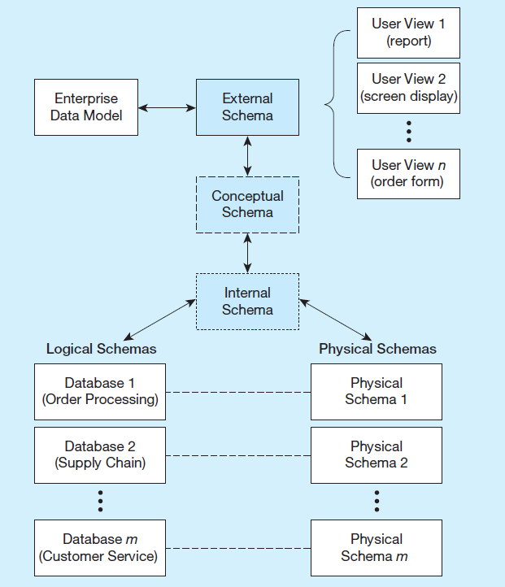
Three-Schema Architecture
Different people have different views of the database
External Schema
User Views
Subsets of Conceptual Schema
Can be determined from business-function/data entity matrices
D B A determines schema for different users
Conceptual Schema (E R models)
Internal Schema (logical and physical structures)
Notes:
The term “schema” here refers to the view you have of the system being developed. Users of a system have one view, based on the reports, forms, and interactions they have with the system. Designers have a view of the entities, attributes, and relationships involved in the world being modeled (the conceptual schema), as well as a view of tables, fields, and primary and foreign keys, together with an understanding of what makes a database well structured and efficient (the internal schema).
If you are a database designer, you will be extensively involved in the logical and physical pieces of the internal conceptual schema. You will be particularly involved in the physical schema if you are a database administrator (DBA). If you are a user, these schemas don’t matter much to you; rather you will be involved in the external schema.

Slide 42
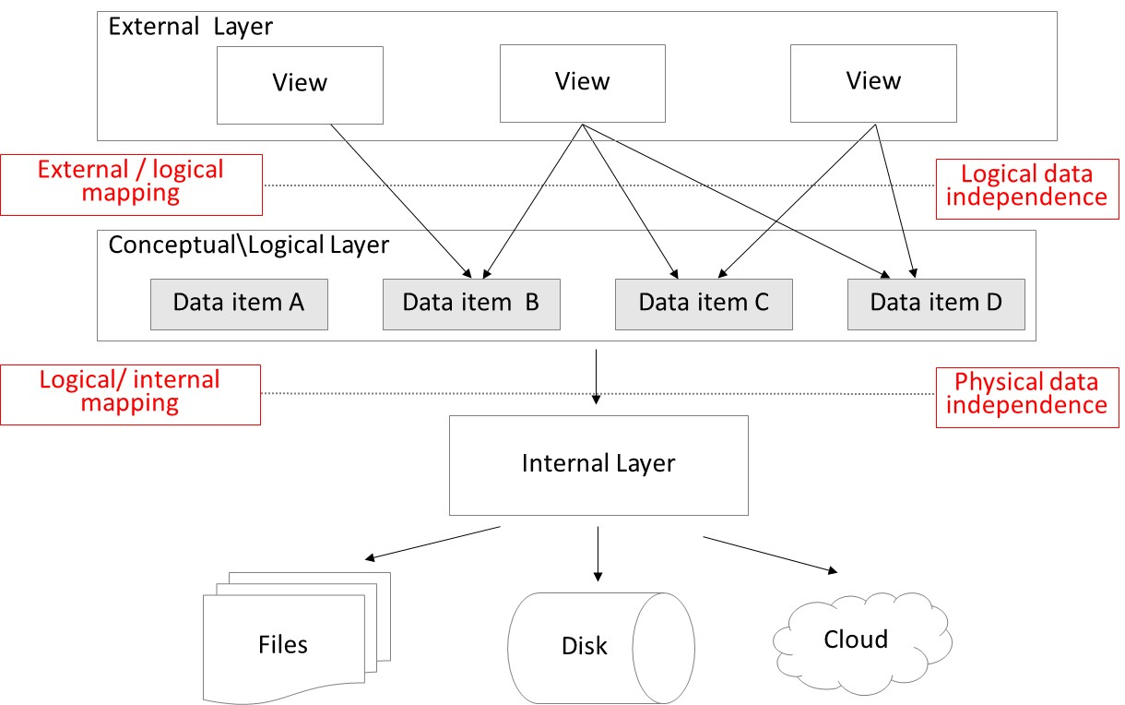
The Three Layer Architecture
physical data + logical data independence!
Notes:
Data independence implies that changes in the data definitions have minimal or no impact on the applications using the data. These changes can occur in the conceptual or physical layer
Phisical independence implies that the applicaitons , views, or logical data models need not be changed when changes are made to the data storage specifications in the physical model in the internal layer
Logical data independence implies that the software applications are minimally affected by changes in the conceptual or logical model or layer
A Mapping between external and logical layer leads to logical data independence
And
A mapping between Logical and internal or physical layer leads to Physical data independence

Slide 43
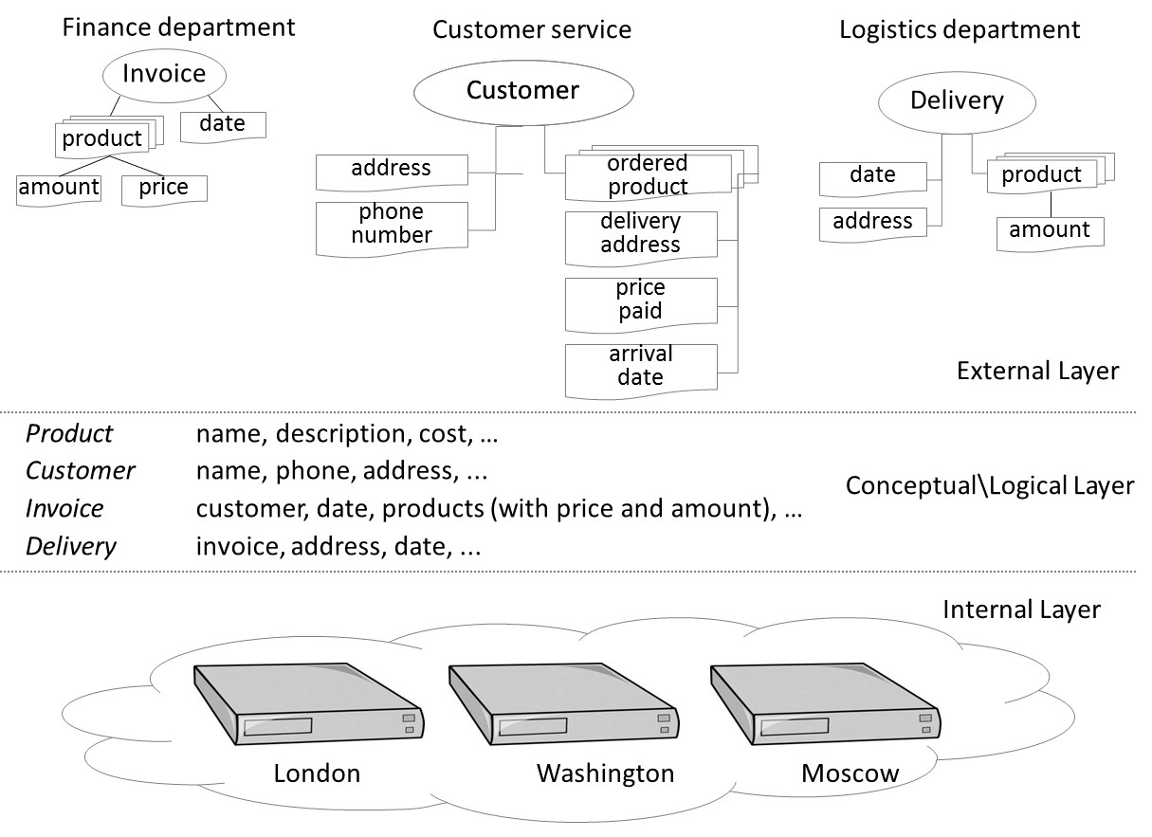
The Three Layer Architecture – Procurement Process
Notes:
Here is an example of the 3 layered architecture for a business procurement process
The external layer being the views and business requiremetns mapping to the Conceptual and logical Layer
Next The Conceptual and logical Layer being the mapping to the physical layer
Andfinally the internal layer being the persistent storage of data mapped in the internal layer

Slide 44
Computer Setup
Install SQL Server 2019 Express Edition
https://www.microsoft.com/en-us/sql-server/sql-server-2019
Install SQL Server Management Studio
https://docs.microsoft.com/en-us/sql/ssms/download-sql-server-management-studio-ssms?view=sql-server-2017
To Install SQL Server for Mac or use Virtual Box
https://learnsqlteam.com/2020/05/15/installing-mssql-on-mac/
Both the tools are required for Part I for data model and SQL assignments

Slide 45
Computer Setup
Install “Databricks Community Edition”
https://databricks.com/product/faq/community-edition
Install Tableau (student free license, use umbc email and student ID for registration)
https://www.tableau.com/academic/students
To Install AWS free Tier
https://aws.amazon.com/free/?all-free-tier.sort-by=item.additionalFields.SortRank&all-free-tier.sort-order=asc&awsf.Free%20Tier%20Types=*all&awsf.Free%20Tier%20Categories=*all

Slide 46

Copyright © 2019, 2016, 2013 Pearson Education, Inc. All Rights Reserved

